Slide 1


GitHub Repository https://github.com/MLDB2020/MLDB

Slide 2
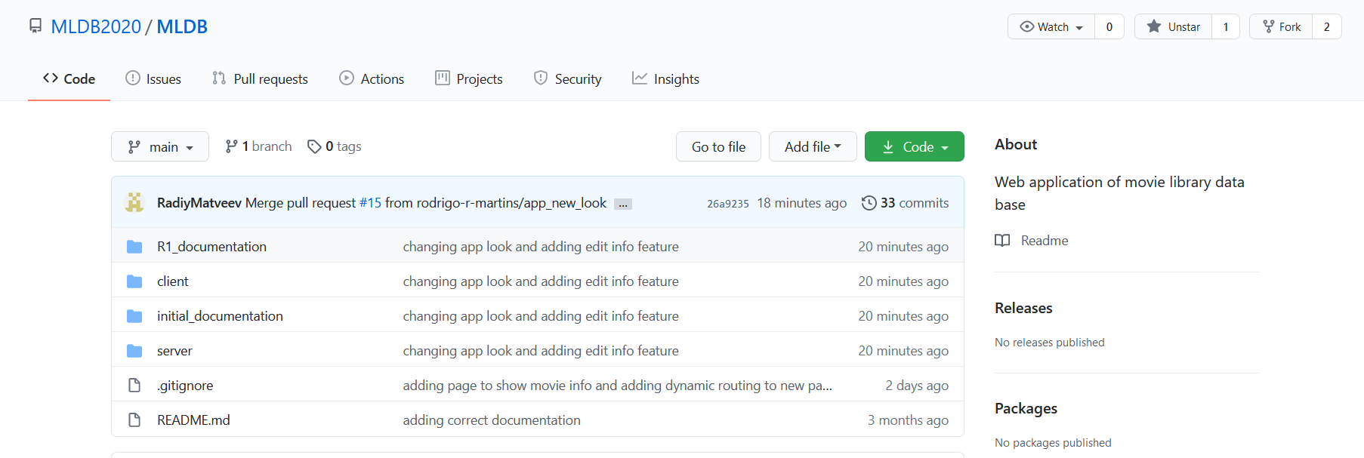
Root

Slide 3
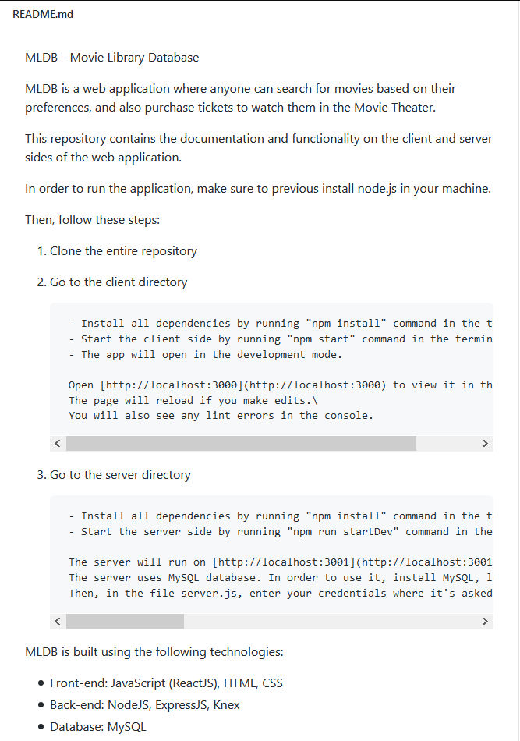
Readme (Build/Deployment Procedures)

Slide 4
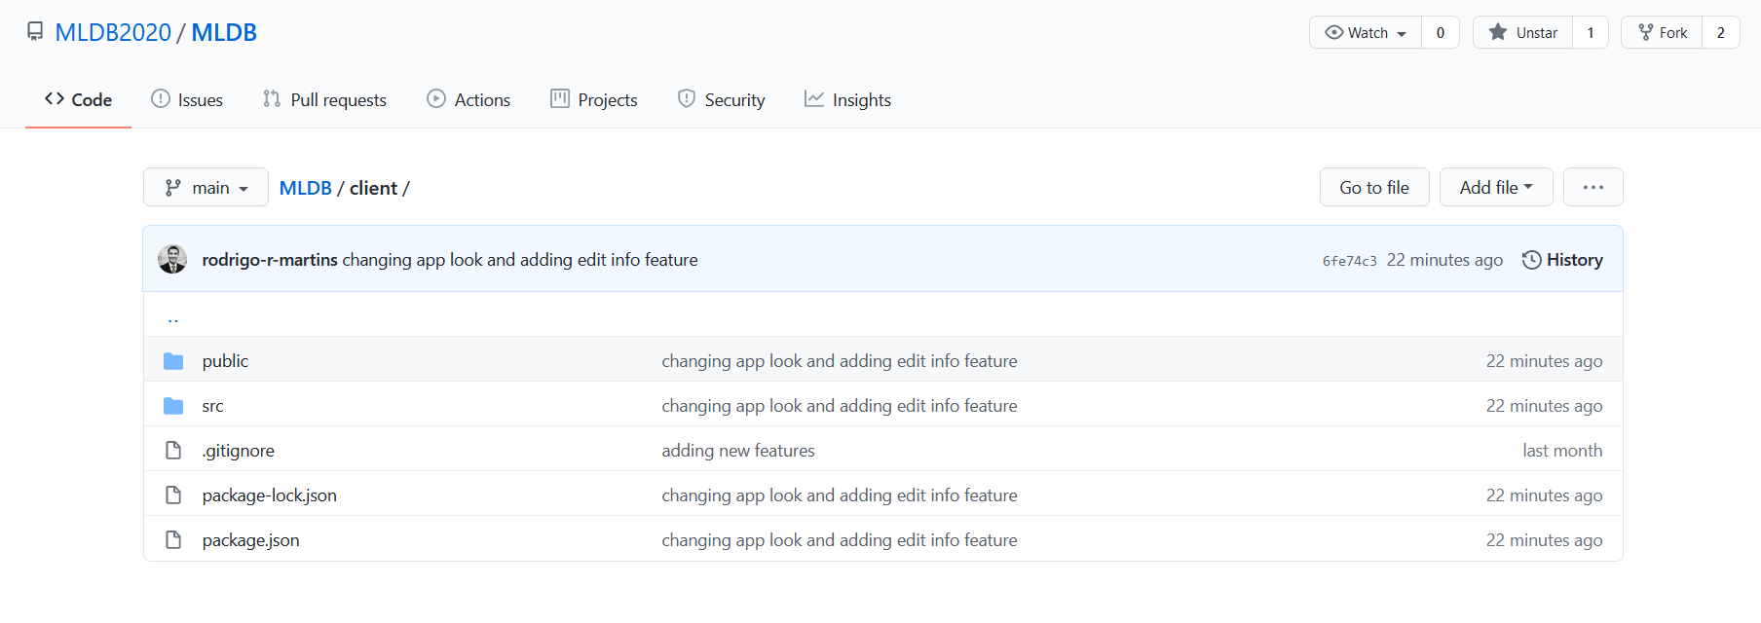
Client folder

Slide 5
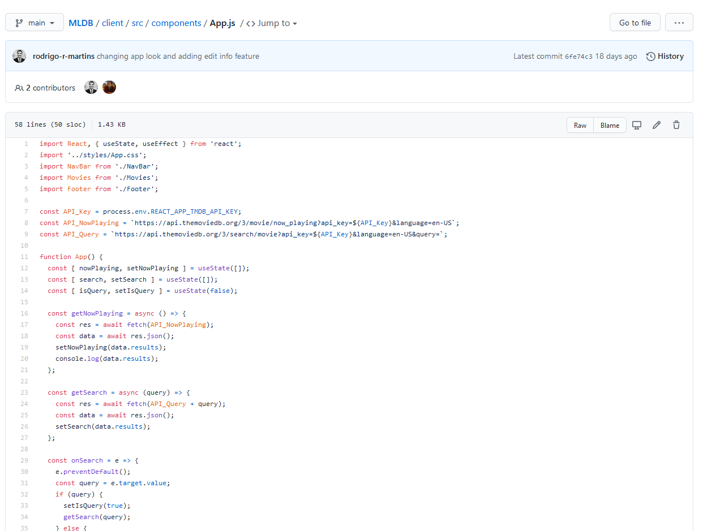
App Root Component – Code Overview

Slide 6
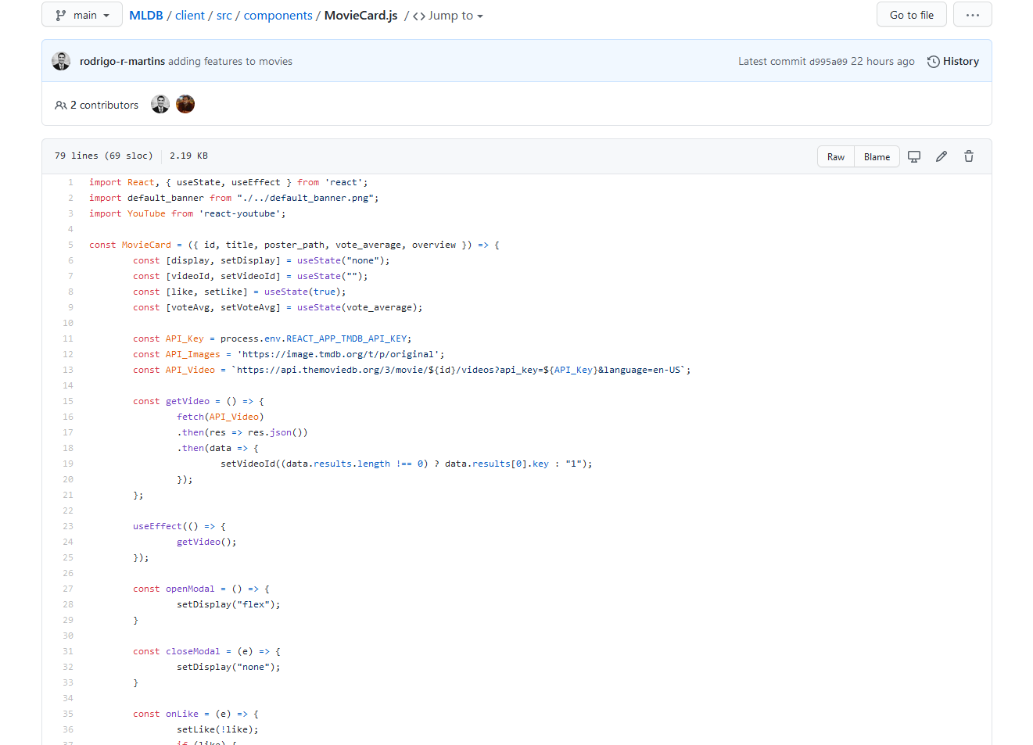
Movies Component

Slide 7
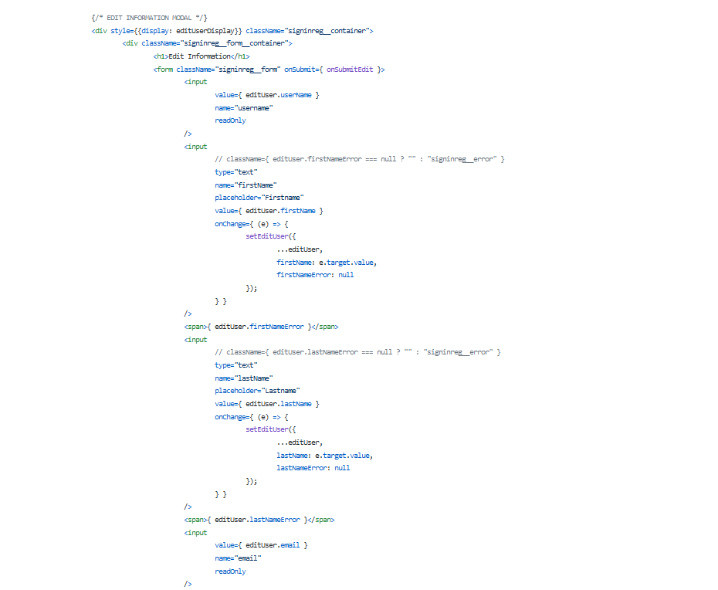
Edit Information Sample Code

Slide 8
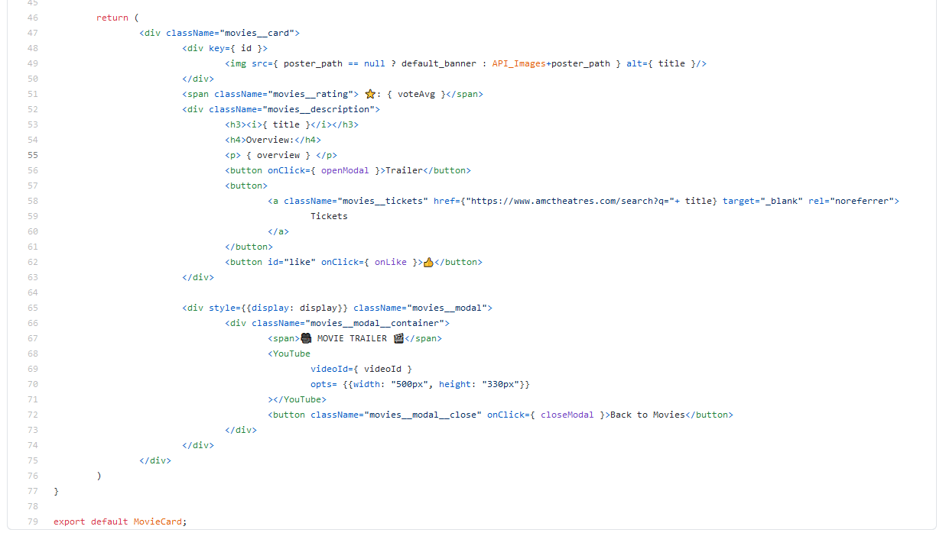
Available Tickets Sample Code

Slide 9
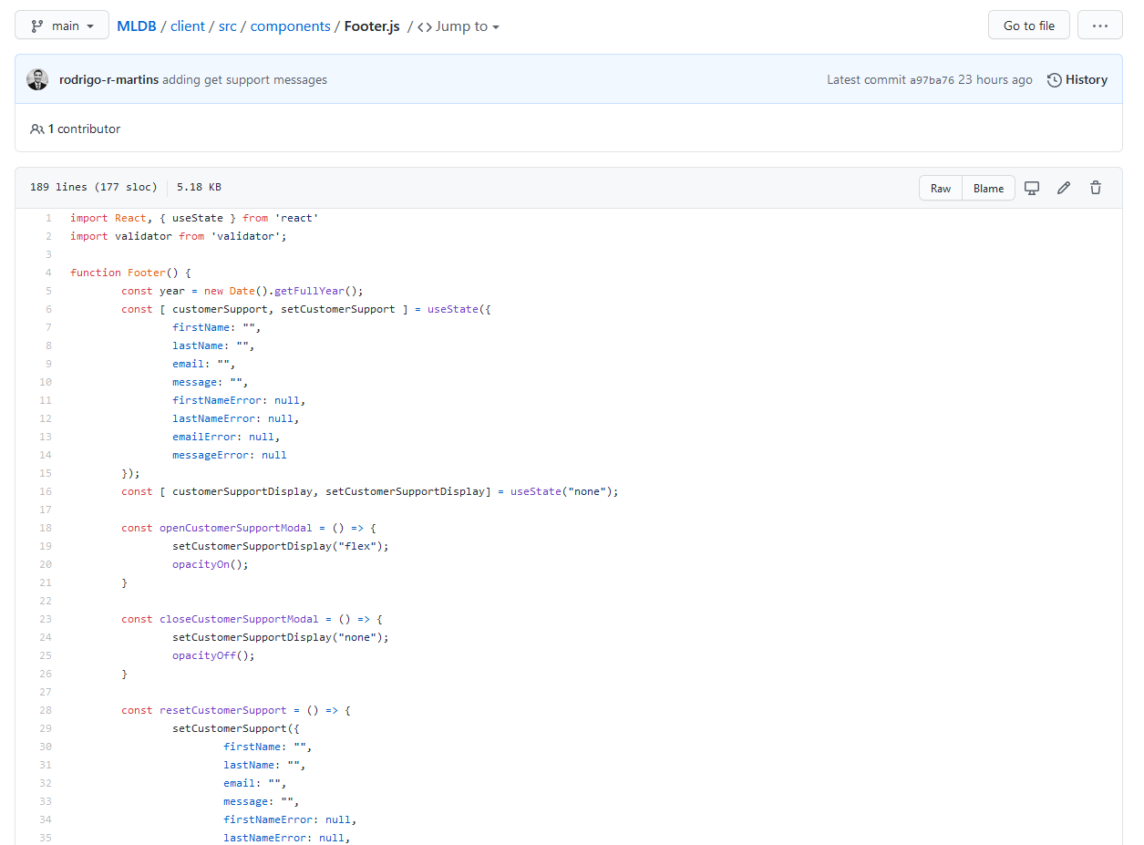
Customer Support Sample Code

Slide 10
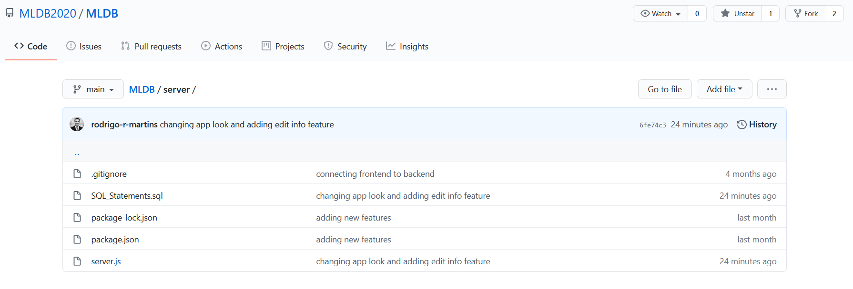
Server folder

Slide 11
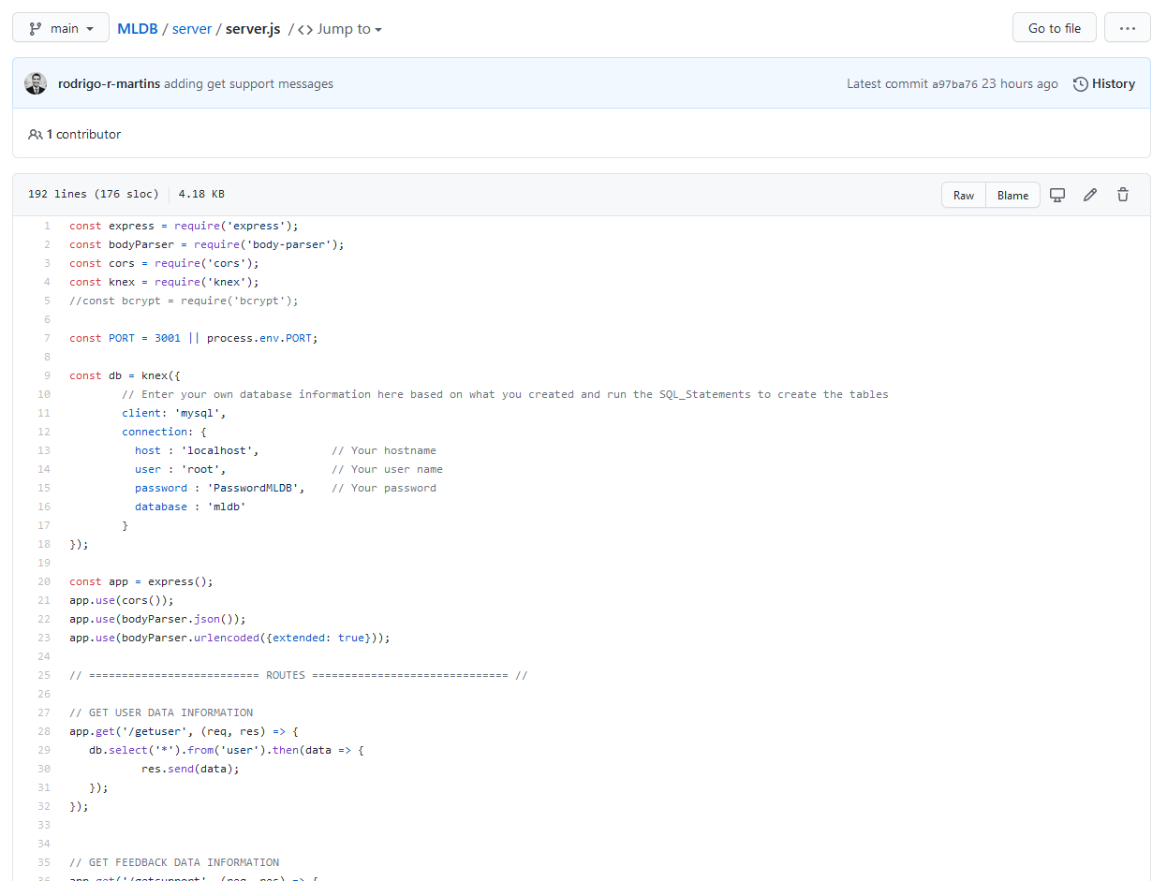
Server – Code Overview

Slide 12
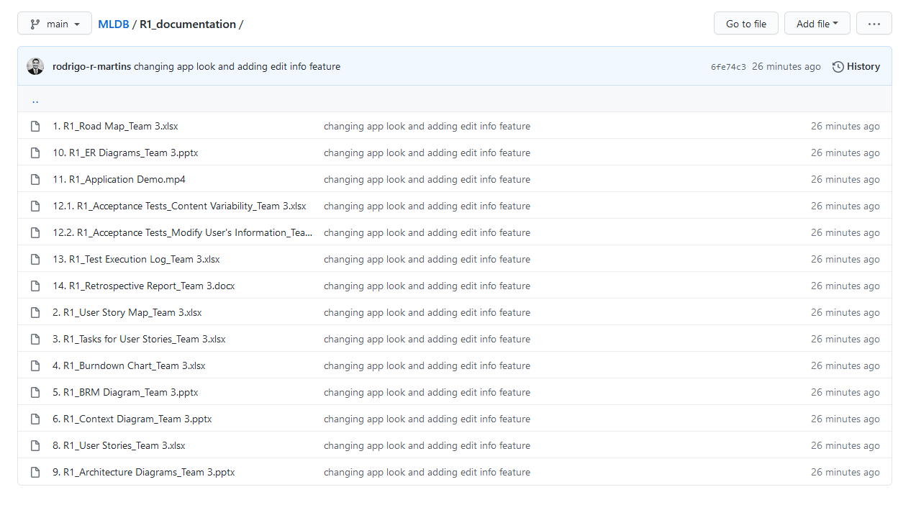
R1 Documentation

